Slide 1
Analyzing Amazon Sales data
Ansh Gupta

Slide 2
PROBLEM STATEMENT
Sales management has gained importance to meet increasing competition and the need for improved methods of distribution to reduce cost and to increase profits. Sales management today is the most important function in a commercial and business enterprise.
Do ETL: Extract-Transform-Load some Amazon dataset and find for me
Sales-trend -> month-wise, year-wise, yearly_month-wise

Slide 3
OBJECTIVE
Find key metrics and factors and show the meaningful relationships between attributes. Do your own research and come up with your findings

Slide 4





PROCESS
Step 1
Step 2
Step 3
Step 4
Step 5
Data Collection
Data Pre-Processing
Exploratory Data Analysis (EDA)
Finding Insights
Tableau Dashboard

Slide 5
DATASET INFORMATION
This dataset includes sales-related information such as sales amount, cost amount, sales prices, list prices, sales margins, and sales quantities from 2010 to 2017.

Slide 6
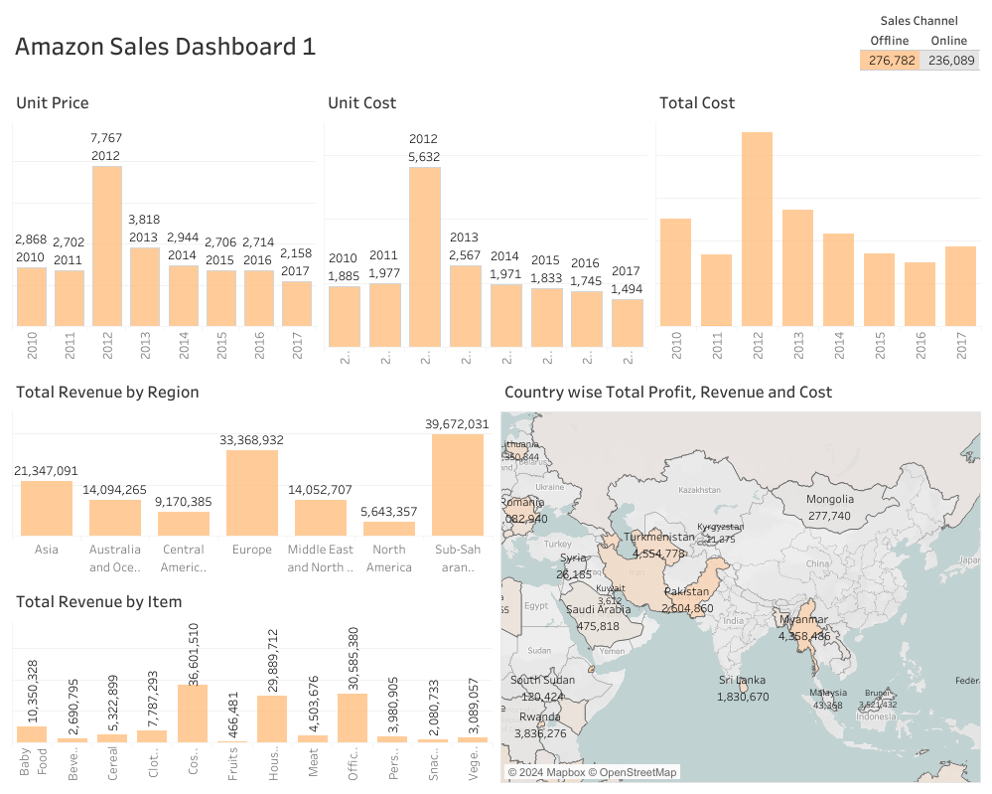

Slide 7
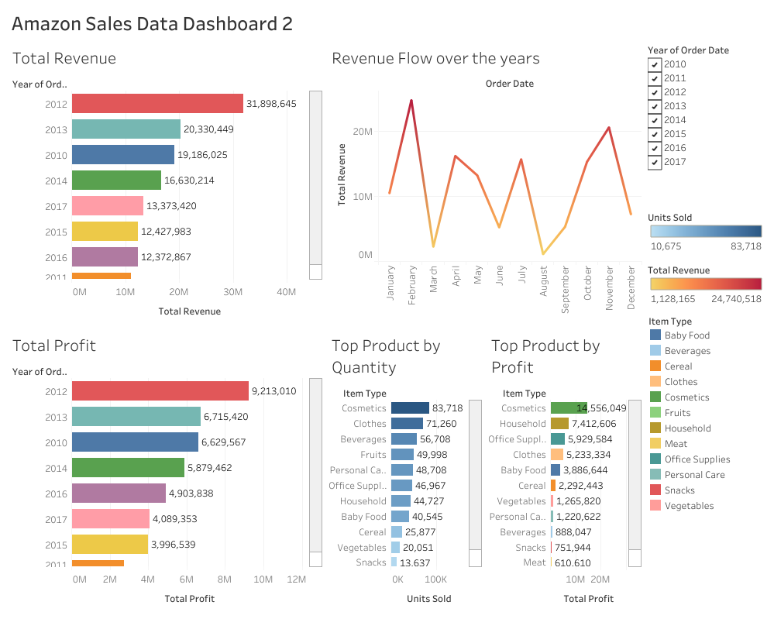

Slide 8
AREAS OF FOCUS
Sales decreased by 10.42% from Jan 2017 to Jan 2018, then by 5.06% from Jan 2018 to Oct 2019.
Profits declined by 6.82% from Jan 2017 to Jan 2018 and by 15.16% from Jan 2018 to Oct 2019.
Better Large Canned Shrimp had the highest sales at $87,73,249.43, 42,85,596.56% more than Kiwi Lox's $204.71.
Better Large Canned Shrimp led in sales with $15,454,172.47, 187.21% higher than Ebony Squash at $5,380,727.75.
Better Large Canned Shrimp topped profits at $5,459,826.26, 129.24% more than Discover Manicotti at $2,381,667.84.
BBB Best Corn Oil had the 5th lowest sales at $327.06, 59.77% higher than Kiwi Lox's lowest sales at $204.71.

Slide 9
SUMMARY
Sales declined by 10.42% from January 2017 to January 2018, then rose by 6.22% from April 2019 to October 2019. Profits decreased by 6.82% from January 2017 to January 2018 and by 15.16% from January 2018 to October 2019. Better Large Canned Shrimp had the highest sales and profits, negatively correlated. Sales and profits diverged the most with this item. Across all items, sales and profits varied significantly.

Slide 10
THANK YOU
Ansh Gupta

